Slide 1
Pathology of Male Reproductive System
G. Mahendra
Dept of pathology

Slide 2
Objectives
To know the different pathologies that can cause prostatic enlargement
To know the different pathologies that cause scrotal swelling
To know the classification of testicular tumours and to learn the morphology of common testicular tumours
To know the pathology of intraepithelial and invasive penile cancer

Slide 3
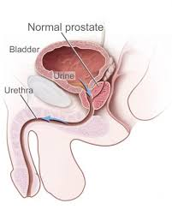
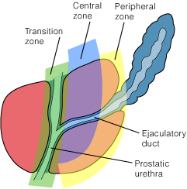
Normal Prostate Gland
A retroperitoneal organ encircling the bladder neck
Weighs about 20g
Palpable on rectal examination
Blood supply-internal iliac artery
Prostatic veins drain into the prostatic venous plexus
The prostatic parenchyma is divided in to four zones
Transitional
Central
Peripheral
Anterior fibromuscular stroma
The type of proliferative lesions are different in these zones
Eg: BNH- transitional zone
Carcinoma –peripheral zone

Slide 4
Microscopy- normal prostate gland
Glands are arranged concentrically around urethra
Inner periurethral group
Submucosal group
External group/ main prostatic glands

Slide 5
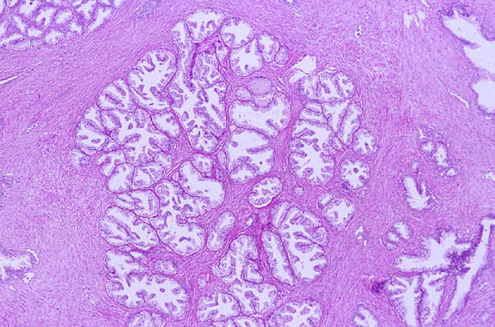
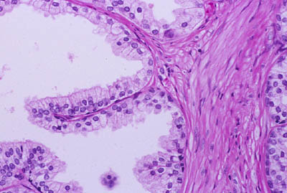
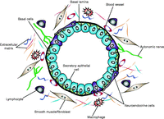
Microscopy- Normal prostate gland
Glandular acini –convoluted appearance with papillary infoldings
Lined by cuboidal- pseudostratified columnar epithelium, lying on a myoepithelial layer
Surrounded by a fibrous tissue stroma

Slide 6
Enlarged prostate gland
Prostatitis
Benign nodular hyperplasia
Prostatic carcinoma

Slide 7
prostatitis
Acute suppurative prostatitis-
secondary to ascending or descending infection
Chronic non specific prostatitis
Folllowing recurrent episodes of acute prostatitis
Lymphocyte and plasma cell infiltrate, acinar atrophy and stromal fibrosis
Granulomatous prostatitis
Tuberculous prostatitis and non specific granulomatous prostatitis
Can mimic malignancy
clinically due to hard enlargement of the gland
Increased serum PSA level

Slide 8
Benign prostatic hyperplasia (BPH)/ Nodular Hyperplasia
A common non-neoplastic condition of prostate gland
Commonly seen after 50 years of age
Occurs due to hormonal imbalance with advancing age.
Reduction in androgen level and relative increase in oestragen level
Mainly involves the periurethral glands
Not a pre neoplastic condition

Slide 9
BPH Morphology
Enlargement of gland (60-100g)
Originates in the periurethal region
Mostly involves the lateral lobes
Characterized by hyperplasia of both stromal and glandular components resulting in formation of discrete nodules
Early nodules stromal hyperplasia
Later –glandular hyperplasia

Slide 10
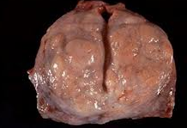
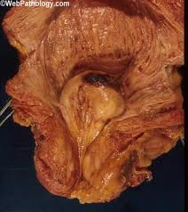
Macroscopy of BPH
The cut surface –multiple, circumscribed,solid nodules and cysts
Nodules compress the prostatic urethra
Sometimes these nodule can protrude up into the bladder neck “Median Lobe”

Slide 11
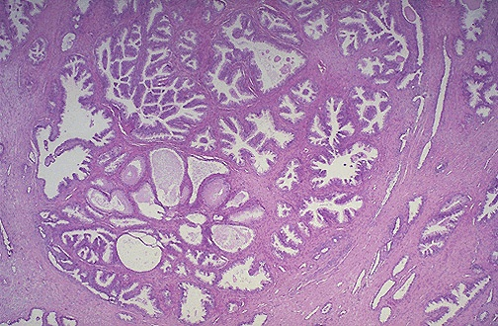
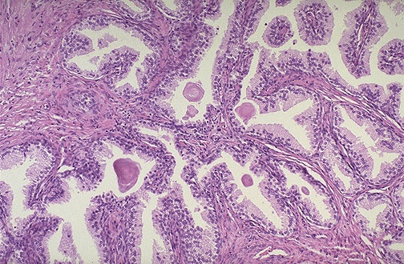
Microscopy of BPH
Formation of nodules of purely stromal fibromuscular to fibroepithelial
This is a large hyperplastic nodule of glands
small to large cystically dilated glands lined by two layers of cells
The glands are well-differentiated and still have some intervening stroma.
Corpora amylacea within the glands

Slide 12
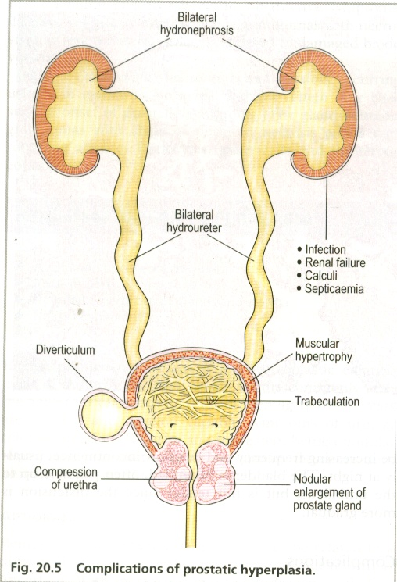
Complications of prostatic hyperplasia

Slide 13
Carcinoma of the prostate gland
One of the commonest cancer seen in males
A tumour of elderly
Aetiology-unknown; probably hormone related
A positive family history increases the risk
BNH is not a pre neoplastic lesion but it is often found coincidental with carcinoma
Involves the posterior subcapsular area of the gland
Is preceded by prostatic intraepithelial neoplasia (PIN)

Slide 14
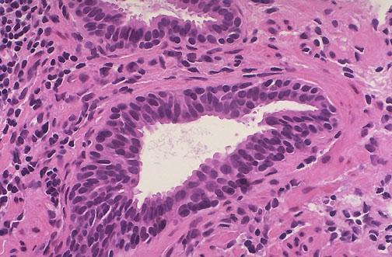
Prostatic Intraepithelial Neoplasia (PIN)
Is a precancerous cellular proliferation
Architecturally normal acini lined by cytologically atypical cells
PIN could be low or high grade
The finding of high grade PIN suggests that prostatic adenocarcinoma may also be present

Slide 15
Prostatic carcinoma-Clinicopathological types
Clinical (symptomatic) carcinoma
Important form
Arises in the posterior subcapsular area
Invades stroma and perineural spaces
Produces metastasis, mainly to bone
Sometimes small primary in prostate with widespread symptomatic metastasis-
“Occult carcinoma”
Latent (Incidental carcinoma)
Microscopic foci of cancer found incidentally on histological examination of prostates removed for BPH
Common , incidence is high in old age
Clinical significance ? read

Slide 16
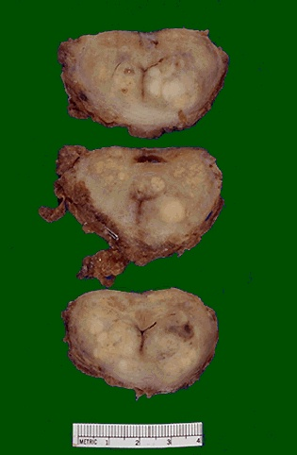
Morphology -Prostatic carcinoma
70% -posterior subscapular location-palpable per rectum
On slicing gritty and firm
Easy to palpate than seen

Slide 17
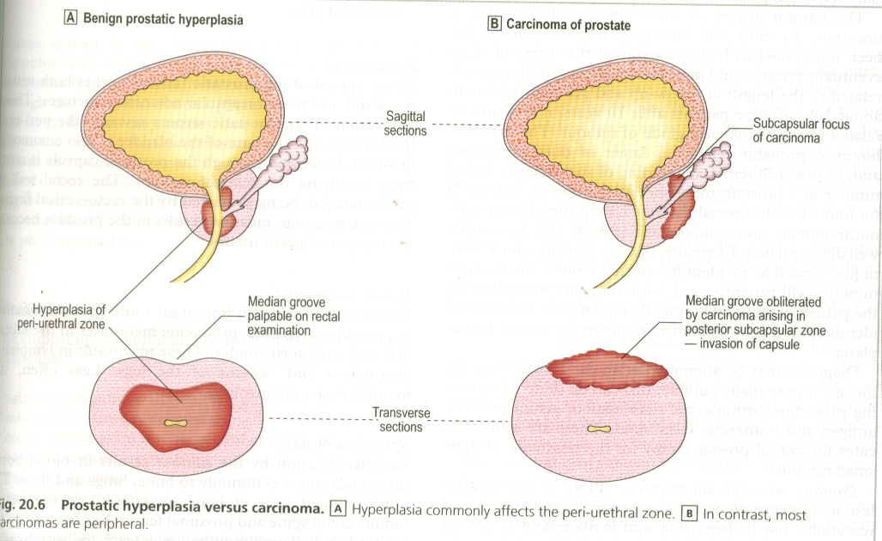
Prostatic hyperplasia versus carcinoma
Prostatic hyperplasia
Prostatic carcinoma

Slide 18
Morphology -Prostatic carcinoma
An adenocarcinoma forming acini and tubules
The neoplastic glands are typically smaller than normal glands, more crowded and lacks branching pattern.
Lined by a single layer of cells
Invasion of the stroma and the perineural space is seen
Gleason’s grading system which is based on architectural pattern of glands is used in determining prognosis

Slide 19
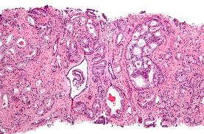
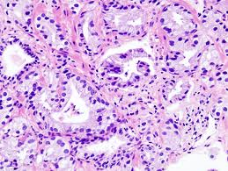
Microscopy of prostatic carcinoma
Small crowded glands
Lined by a single layer of cells

Slide 20
Carcinoma of the prostate gland- spread
Direct spread
stroma-capsule-urethra-bladder base –seminal vesicle
Lymphatic spread
Sacral, iliac ,para aortic nodes
Blood spread
Bone, lung, liver

Slide 21
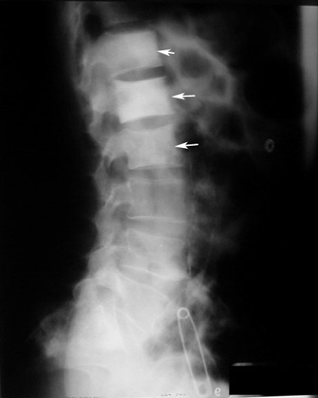
Bone metastasis in prostatic carcinoma
Often gives osteoclerotic metastasis
Sites-lumbar vertebrae
and pelvis
Increased alkaline phosphatase level

Slide 22
Reading assignment
Value of PSA in diagnosing prostatic disorders

Slide 23
Scrotal swelling
Painful
orchitis
Painless
hydrocele
haematocele
varicocele
tumours

Slide 24
Hydrocele
The commonest cause for intrascrotal swelling
Accumulation of serous fluid within the tunica vaginalis of the testis
Congenital hydrocele
Appears in first few weeks of life
Secondary hydrocele
Inflammatory acute
chronic
neoplastic

Slide 25
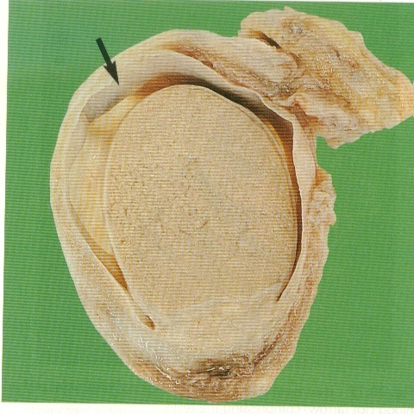
Hydrocele

Slide 26
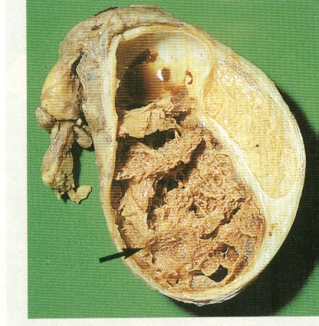
haematocele
A haemorrhage into tunica vaginalis

Slide 27
Testicular tumours
A group of tumours that occurs predominantly in young males
Majority (95%) derived of germ cells.
Others are derived of sex cord-stromal cells, sertoli cells and interstitial cells
Most germ cell tumours are highly aggressive with wide dissemination; but responds very well to current therapy
Sex cord stromal tumours are generally benign

Slide 28
Testicular tumours-Aetiology
Maldesended testis
Testicular dysgenesis syndromes
Increase in oestragenic substances in the environment
Strong familial predisposition

Slide 29
Reading assignment
Cryptoorchidism/ maldescended testis
Embrylogy
Presentations
Problems associated

Slide 30
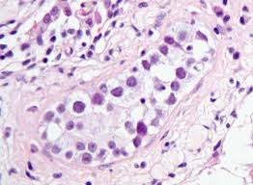
Intratubular germ cell neoplasia
Precursor lesion of testicular germ cell tumours
Carcinoma-in-situ in seminiferous tubules
Large and pleomorphic cells in tubules
Also seen in cryptoorchid testis

Slide 31
Testicular tumours-classification
Seminoma
Non seminomatous germ cell tumours (NSGCT)
Teratoma
York sac tumour
Embryonal carcinoma
choriocarcinoma
Mixed germ cell tumours
Germ cell origin
Non germ cell origin
Sex cord stromal
Leydig celltumour
Sertoli cell tumour
Lymphomas
sarcomas

Slide 32
Germ cell tumours-classification
Different systems are being used by Americans and British
Simply
Seminomas-tumour cells resemble primodial germ cells
Non seminomatous tumours- undifferentiated cells that differentiate into various lineages
Embryonic stem cell-Embryonal carcinoma
York sac tumour
Choriocarcinoma
teratoma
Some tumours – admixture of seminomatous and non seminomatous components

Slide 33
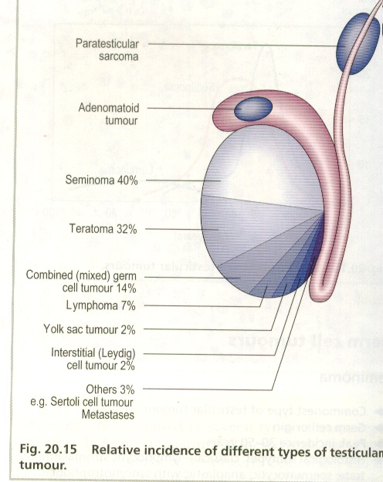
Testicular tumours-classification

Slide 34
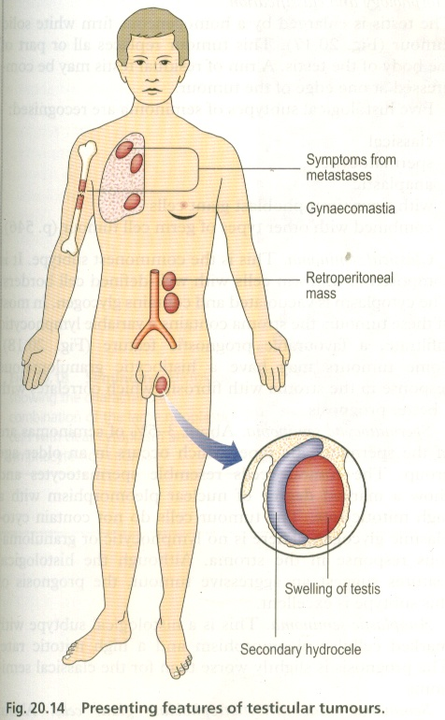
Testicular tumours-presenting features

Slide 35
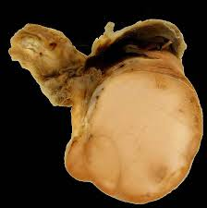
seminoma
The commonest type of testicular tumour
Germ cell origin
Peak incidence occurs in 30-50 years of age
The testis is enlarged by homogenous firm whitish tumour
Usually no haemorrhage or necrosis

Slide 36
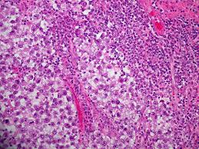
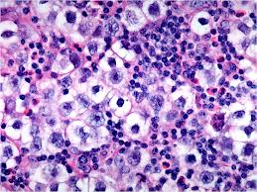
Seminoma
The tumour is composed of large cells with clear cytoplasm separated by lymphocyte rich stroma.
Histologically identical to ovarian dysgerminoma (ref Ovarian tumours)
Responds to radiotherapy well.

Slide 37
Teratoma
A tumour representing differentiation of germ cells along somatic cell lines
Can occur at any age; infancy-adult life
Peak incidence is 20-30 years
Tumour composed of tissue representing endoderm, mesoderm and ectoderm

Slide 38
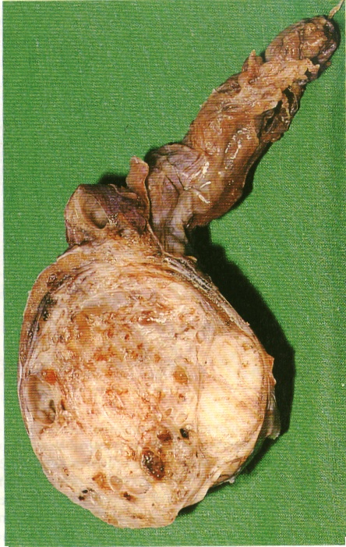
Teratoma
In contrast to seminoma heterogenous appearance
solid tumour with cystic spaces
haemorrhage and necrosis

Slide 39
Microscopy –teratoma
Composed of heterogenous collections of differentiated or organoid structures
Neural tissue, muscle, cartilage, bone, squamous islands thyroid tissue , bronchial epithelium etc
These elements may be
mature-resemble adult tissue
Immature-resemble fetal tissue
Malignancy can arise in these non germ cell components
Squamous cell carcinoma
Mucinous adenocarcinoma

Slide 40
Teratoma
Histologically three major varients
Mature teratoma-contain fully mature tissue of one or more germ cell layer
Immature teratoma –contain immature somatic elements reminiscent of those of developing fetal tissue
Teratoma with malignant transformation –development of frank malignancy in preexisting teratomatous component

Slide 41
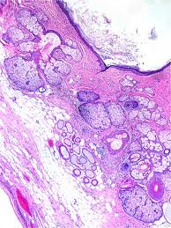
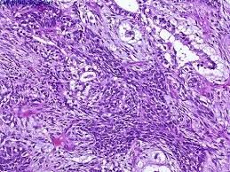
Mature teratoma
Immature teratoma

Slide 42
Teratomas
Pure differentiated mature teratomas in prepubertal age is usually benign
All testicular teratomas in adults are regarded as malignant

Slide 43
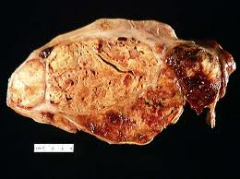
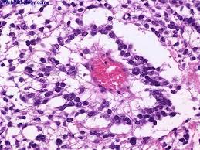
York sac tumour
Most common primary testicular tumour of children less than 3 years
Good prognosis in this age group
αlpha feto protein levels are increased in almost all instances

Slide 44
Behaviour of germ cell tumours of testis
Seminomas are confined to testis for a long duration
NSGCT presents with advanced clinical disease
NSGCT –haematogenous spread is frequent
Seminomas are biologically more aggressive than NSGCT
Seminomas are extremely radiosensitive
NSGCT are less radiosensitive

Slide 45
Tumour markers in testicular tumours
Certain tumour products appear in serum with some testicular tumours
Important in
assisting the diagnosis
staging the disease
Assessing tumour burden
monitoring the response to therapy
early detection of tumour recurrence
Read further on tumour markers in testicular tumours

Slide 46
Tumour markers in testicular tumours
Tumour marker | Type of tumour
α feto protein | York sac tumour
β hCG | . Choriocarcinoma . Other tumours with a trophoblastic component
PLAP | seminoma
These markers can be demonstrated in the tissue sections
using immunohistochemical technique

Slide 47
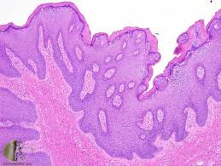
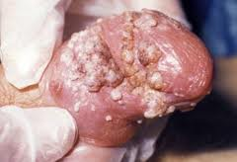
Penile tumours
Tumours of the penis are, on the whole, uncommon.
Most frequent are
Carcinoma
Carcinoma in-situ
Invasive carcinoma
Condyloma acuminatum
Benign and sexually transmitted tumour
Caused by HPV (HPV type 6 and 11)

Slide 48
Carcinoma-in-situ
Two distinct HPV (Type 16) related lesions
Bowen disease
Bowenoid papulosis
Both show similar histological features
Epidermal proliferation with numerous mitoses
Atypical mitoses
Markedly dysplastic cells
Intact basement membrane

Slide 49
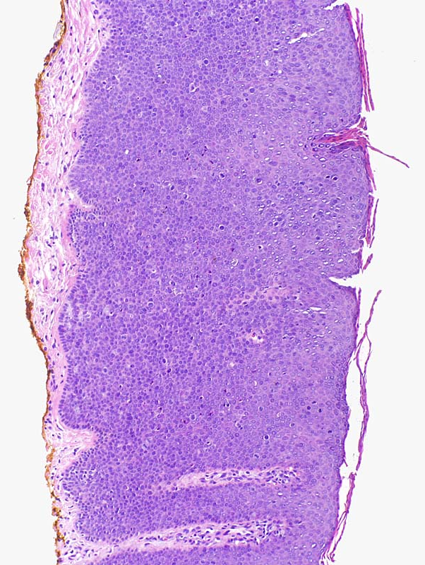
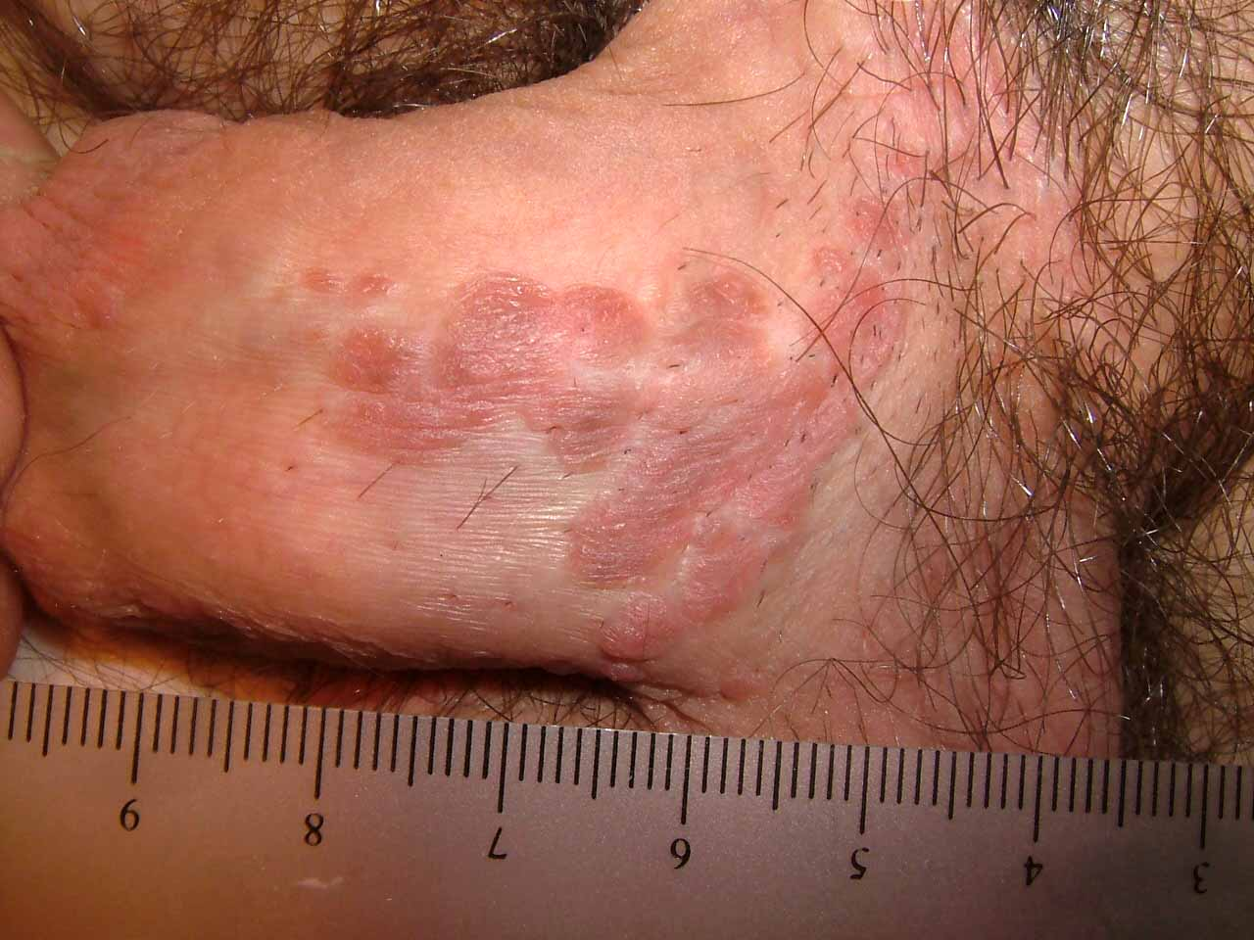
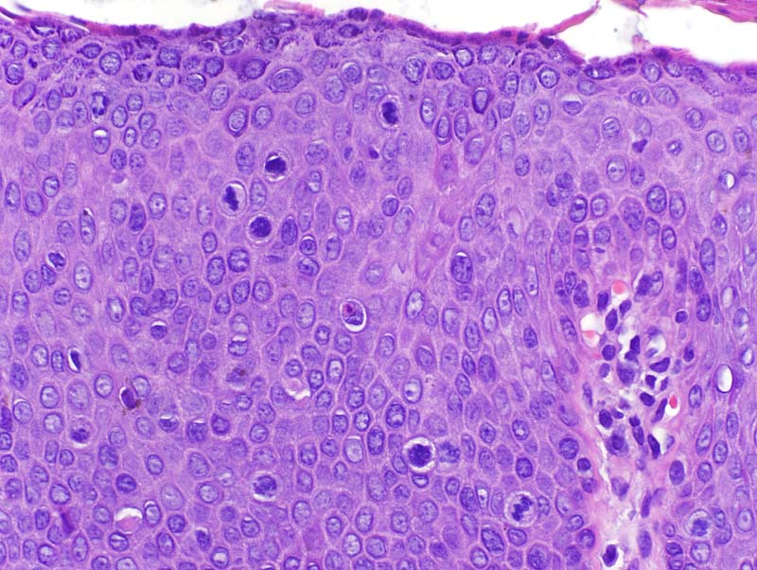
Carcinoma in-situ

Slide 50
Bowen disease
Over the age of 35
Solitary, thickened, gray white plaque on shaft of penis
Single/multiple shiny red plaques on glans
In 10% transform into invasive SCC
Bowenoid papulosis
Sexually active adults
Multiple reddish papulles
Never develops into invasive carcinoma

Slide 51
Invasive squamous cell carcinoma of penis
Relatively common in Asian and African population
Related to HPV (type 16)
Not seen in circumcised males
Macroscopically-
Glans penis or inner side of prepuce
Indurated nodule/plaque or ulcer
Microscopically –well differentiated squamous cell carcinoma

Slide 52
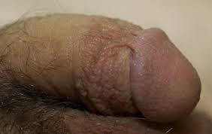
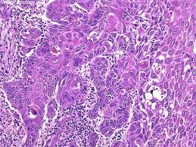
Penile cancer

Slide 53
Summary

